Slide 1

IMDB MOVIE Analysis
By: Rudra AggarwaL

Slide 2
IMDB Movie Analysis Project - Description
The dataset provided is related to IMDB Movies.
A potential problem to investigate could be: "What factors influence the success of a movie on IMDB?“
Here, success can be defined by high IMDB ratings.
The impact of this problem is significant for movie producers, directors, and investors who want to understand what makes a movie successful to make informed decisions in their future projects.
Here, you'll explore the data to understand the relationships between different variables. You might look at the correlation between movie ratings AND THE IMPACT OF OTHER FACTORS ON IMDB.

Slide 3
Approach
Download the dataset and open in Excel for analysis
Clean the datasets. It includes handling missing values, removing duplicates, converting data types if necessary, and possibly feature engineering.
Process the data to answer the asked questions
Use formulas, filters, pivot tables and other functions for finding insights
Create charts and graphs for easy and meaningful data representation
Create report and submit the project

Slide 4





Tech Stack Used

Slide 5
Findings & Insights
Originally the dataset(IMDB Movie Analysis) had 5037 rows.
Removed empty rows, special characters, and duplicate values
Columns that were not relevant in finding insights were hidden
Before cleaning we had 5037 rows (including headings in first row)
After cleaning we have 3757 rows (including column headings in first row)
The new dataset was then used for further analysis for correctness of data.

Slide 6
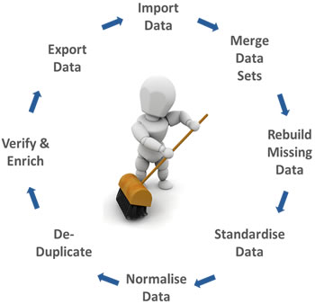
Data cleaning and Preprocessing
We used python in Google colab for cleaning and preprocessing of data.
Colab Link
After we got the dataset we manipulated the genre column and split it into individual columns.
We used various Excel functions like AVERAGEIF, MEAN , MEDIAN, VAR to calculate descriptive statistics and impact of these on IMDB Score for the movies
Cleaned Dataset: Dataset
Here is the final Excel sheet attached Dataset Final

Slide 7
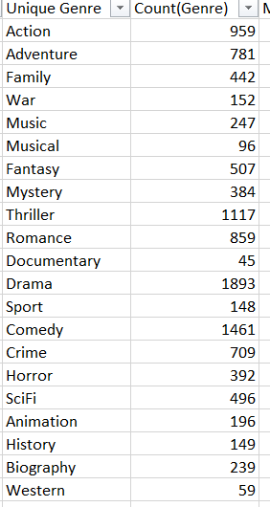
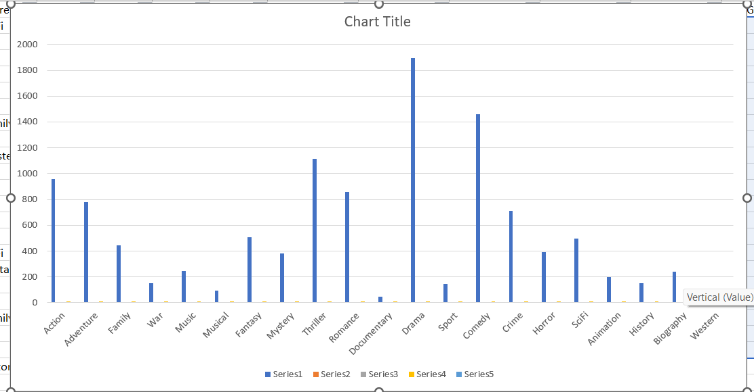
Movie Genre Analysis: Analyze the distribution of movie genres and their impact on the IMDB score.

Slide 8
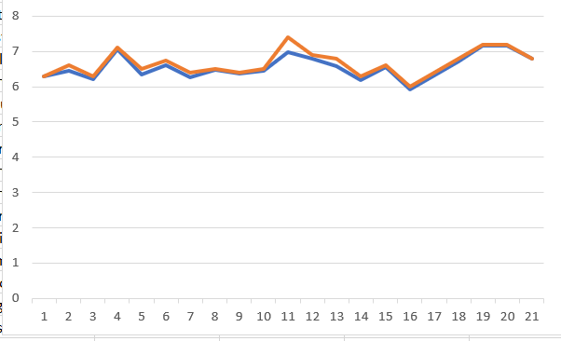
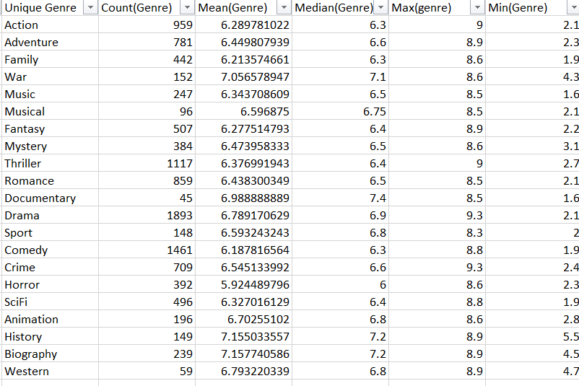
Descriptive Statistics Based on genre
Table containing mean median variance based on genre
Mean Vs Median based on genre
As the mean is almost equal to the median, it indicates that the data is approximately symmetrically distributed. In a symmetric distribution, the mean and median values are close to each other and are often around the center of the data therefore affects the da

Slide 9
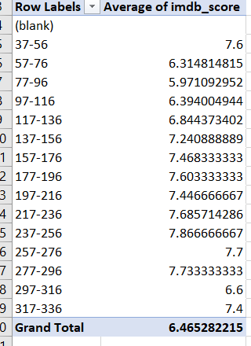
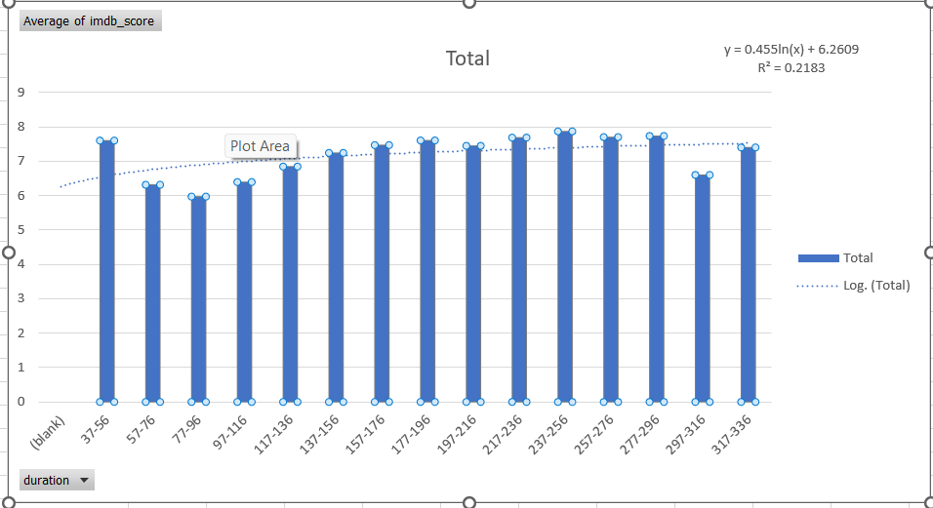
Movie Duration Analysis: Analyze the distribution of movie durations and its impact on the IMDB score.
Pivot table for duration
Plot showing duration vs IMDB score
A small value of R indicates that duration of the movie has much less significance on the IMDB score of the movie.

Slide 10
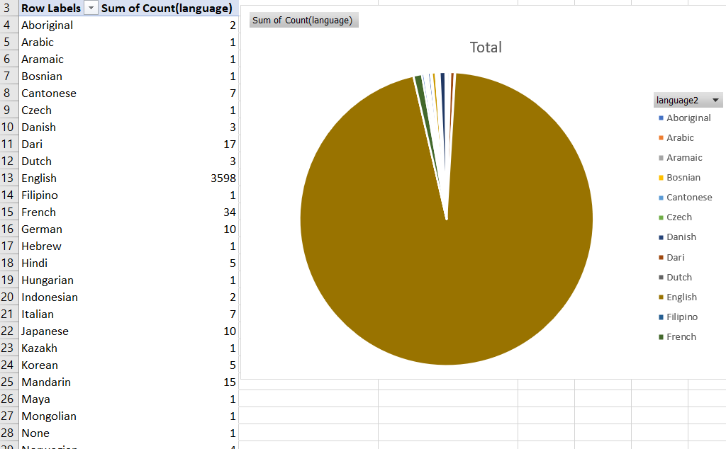
Language Analysis: Situation: Examine the distribution of movies based on their language.
Pivot table for language
Pie chart for distribution
As observing the given pie chart, The English language has overwhelming advantage on the IMDB score.
It maybe due to reason that English is a universal language therefore higher the viewer count, more the ratings given.
English

Slide 11
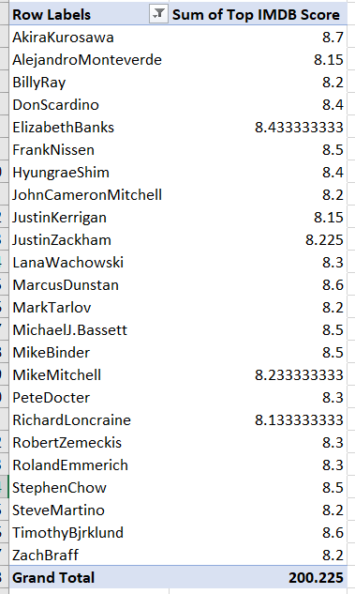
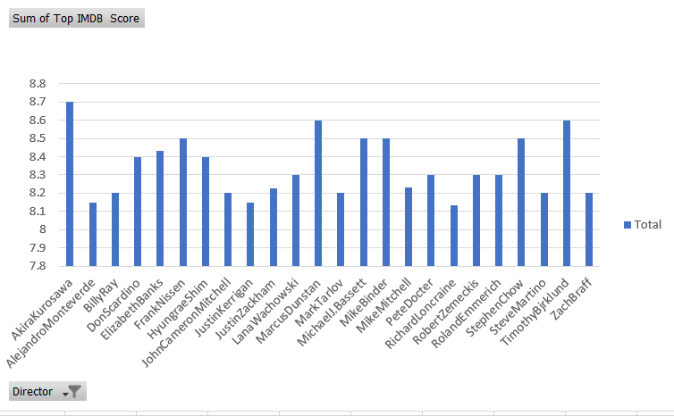
Director Analysis: Influence of directors on movie ratings.
Pivot Table (Director)
Average Score vs Director(TOP) Chart
Best director is
Akira Kurosawa with mean IMDB score of 8.7

Slide 12
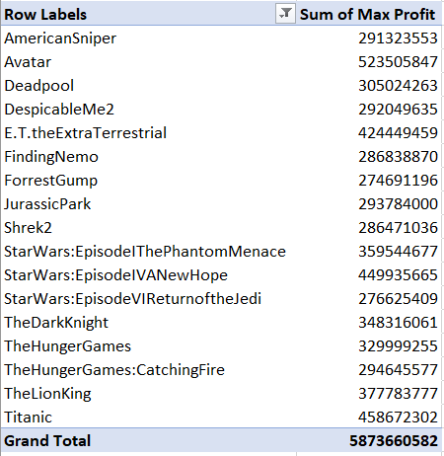
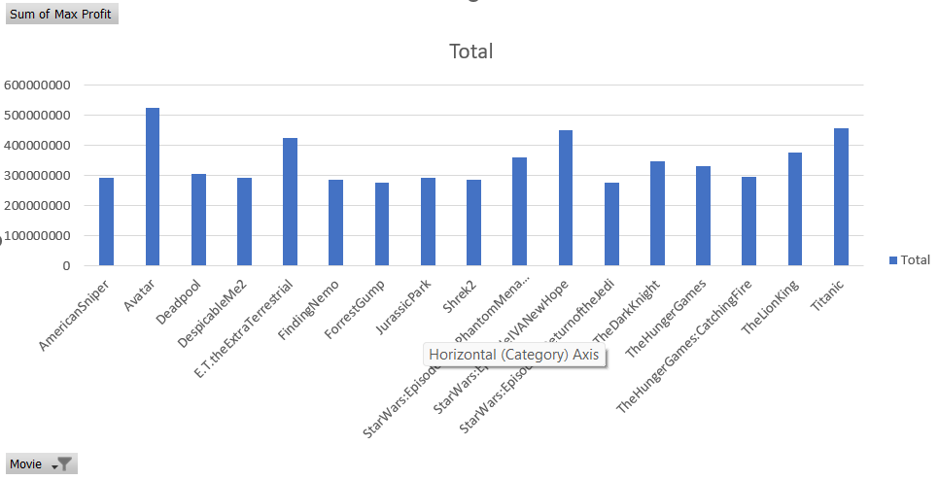
Budget Analysis: Explore the relationship between movie budgets and their financial success.
Top profit earning companies
Gross - budget
Chart showing profit vs movies
Avatar has highest profit.

Slide 13
RESULT
By performing the IMDB Movie Analysis Project
I was able to understand many functions of Excel and able to implement them for calculating descriptive statistics and visualise them using charts and pivot table.
I was able to fulfil all the tasks and the answers posted above are correct to the best of my knowledge.

